Slide 1



Azure Functions vs ASP.NET Core for Web APIs

Slide 2

The boss comes over and says:
Bruh, we need some hands on keys for the new Client Model API.
- Boss

Slide 3
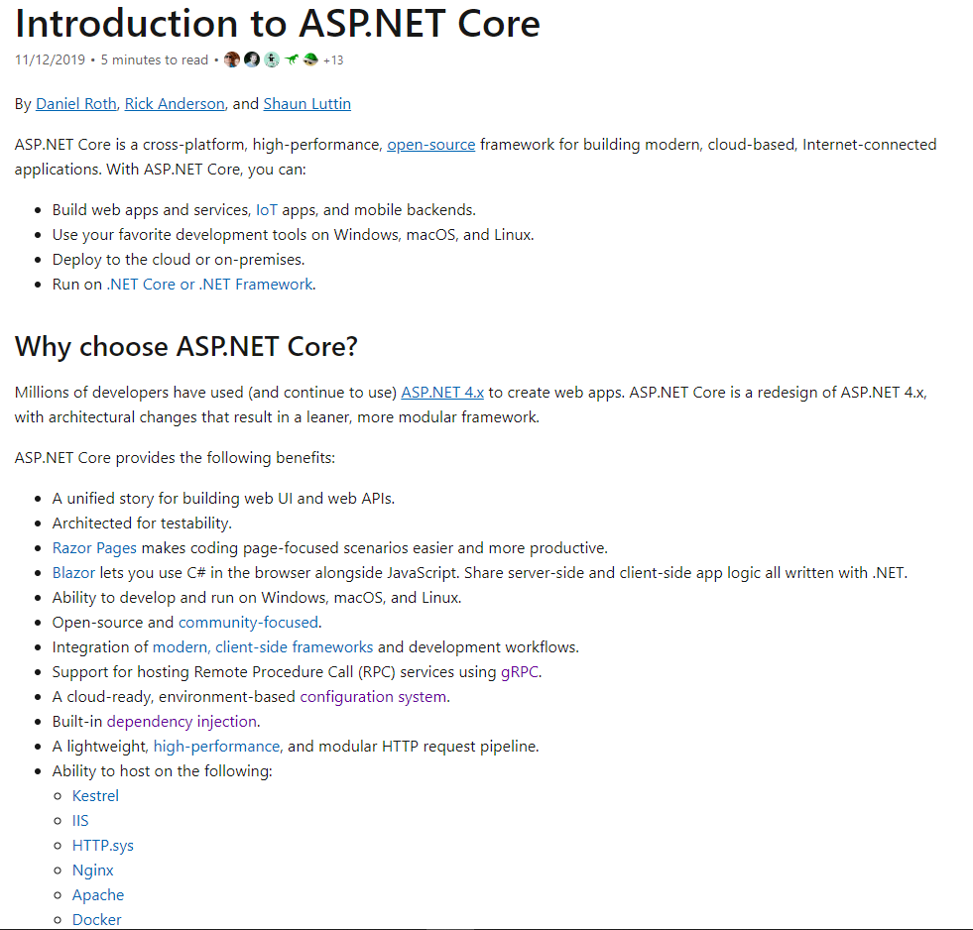
I pick TheRightFramework for Web APIs…

Slide 4
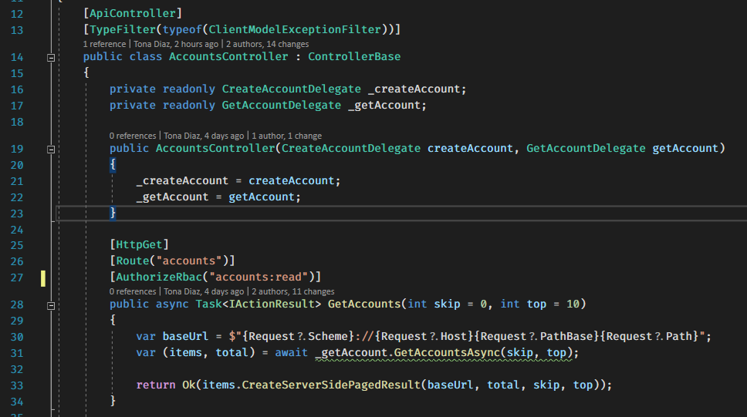
I code it…

Slide 5
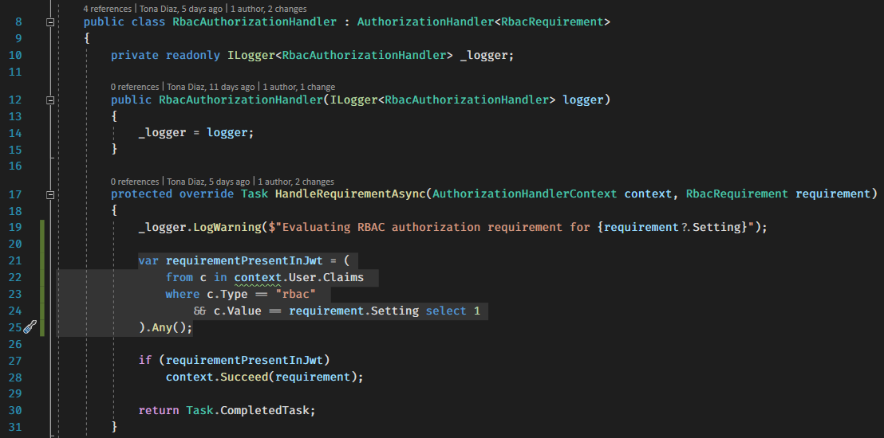
I secure it…

Slide 6
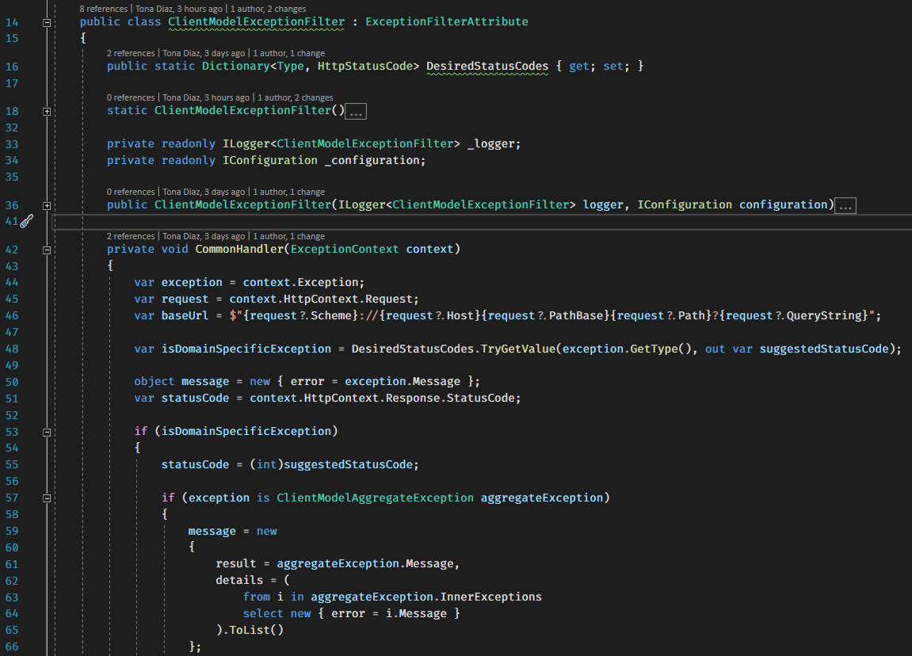
I make it robust…

Slide 7
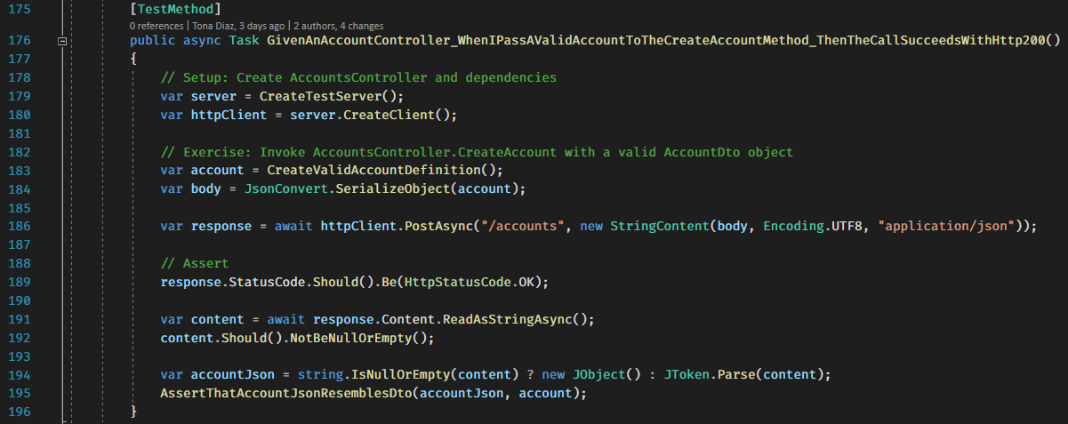
I test it…

Slide 8

Boss’ happy.
Yay!
- Boss

Slide 9


But then, The Chief show up and says:
We need to be using Azure Functions, yo.
Wubba lubba dub dub! Serverless’ hot!
- Tom St. Chief.

Slide 10
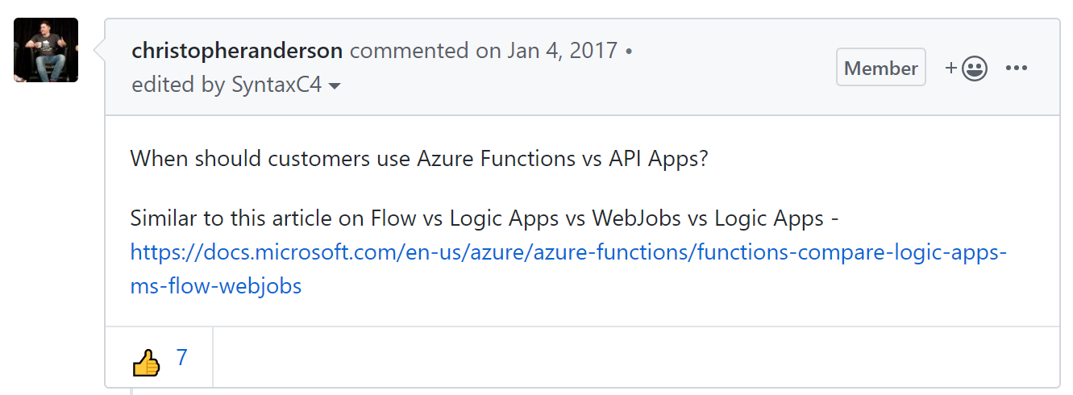
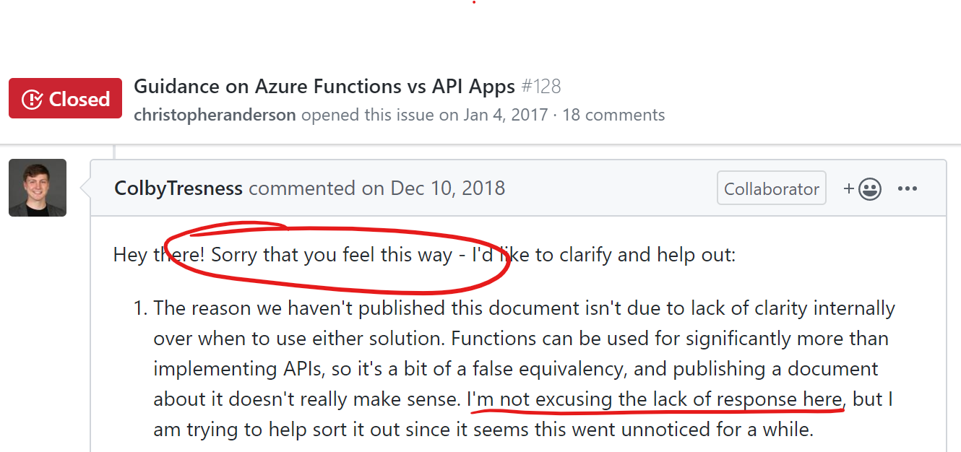
Does Microsoft has any guidelines?

Slide 11


Slide 12


Slide 13
Attempt #1: Function-ize the Controllers.

Slide 14
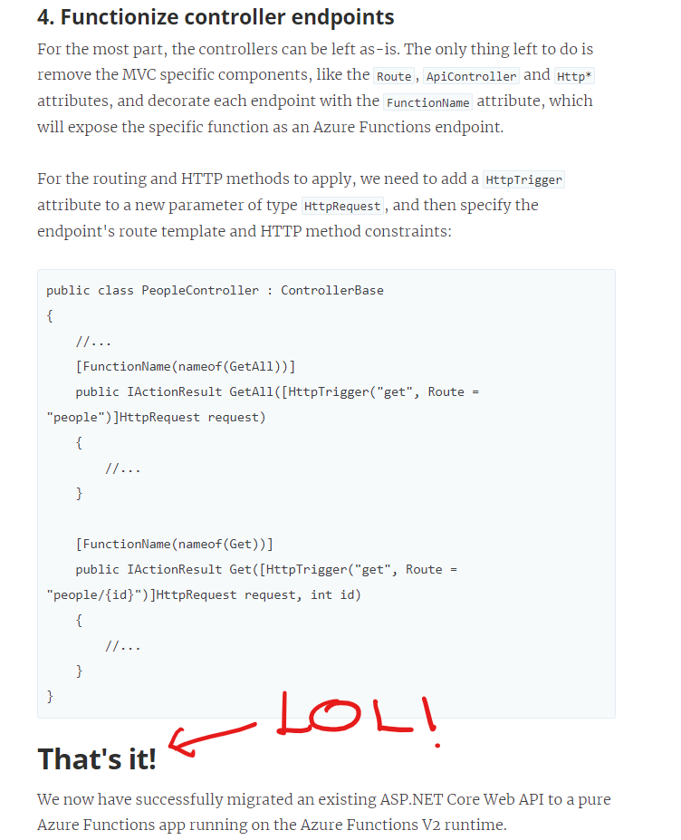
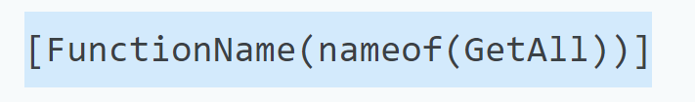

Slide 15
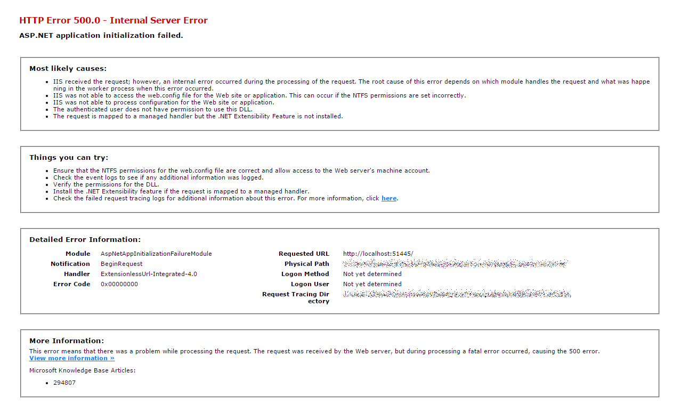
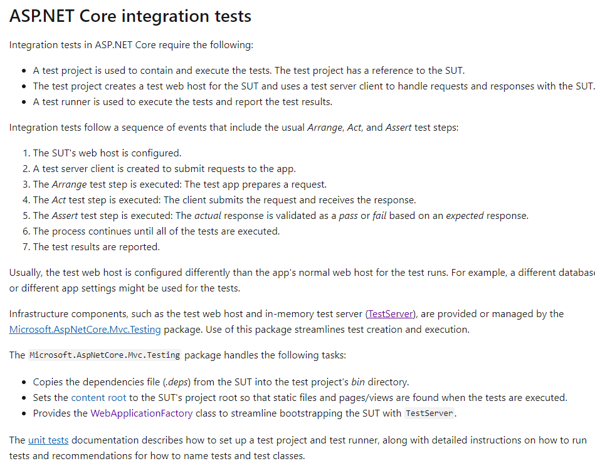
Doesn’t work: no middleware!

Slide 16
Attempt #2: Cheat: use the Test Server.

Slide 17
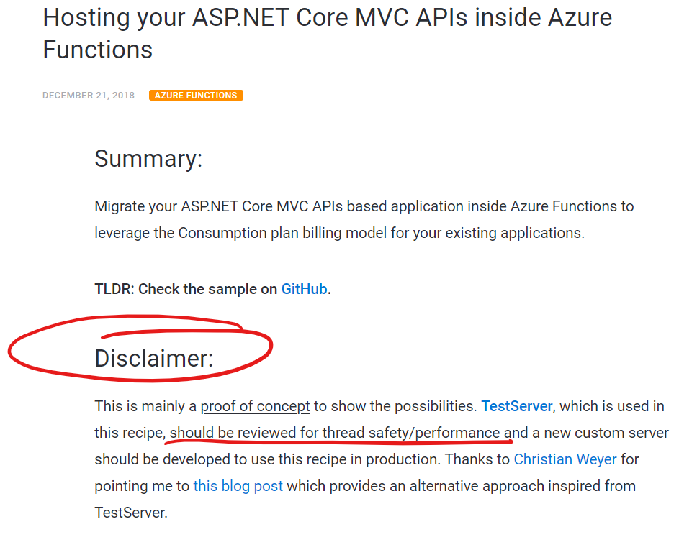
It works, but…

Slide 18
Attempt #3: Move to AWS Lambda.

Slide 19
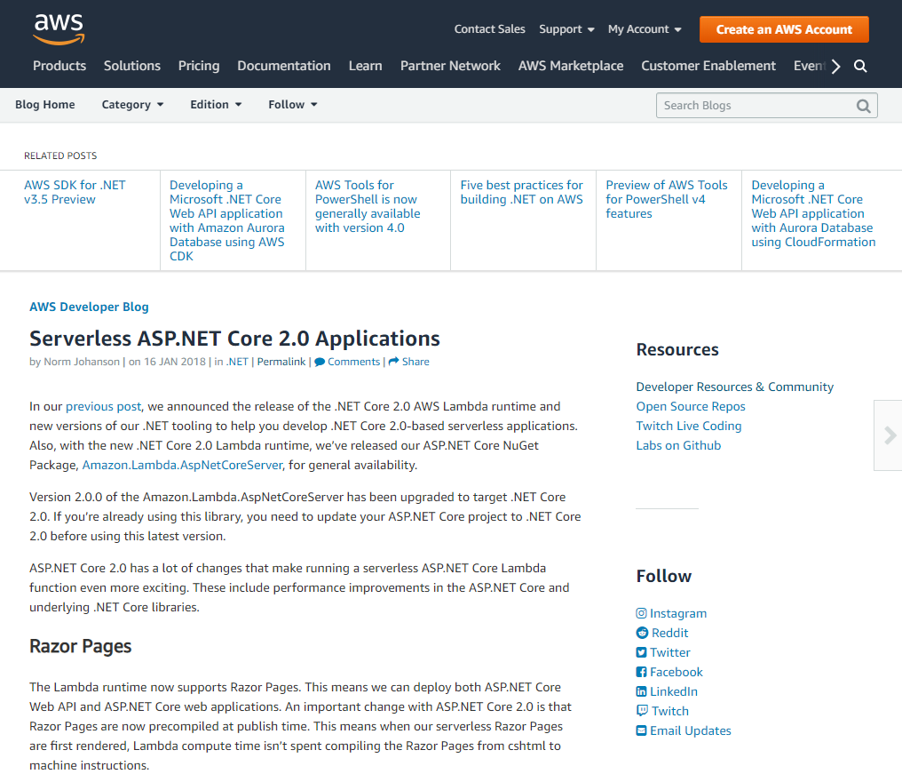

Slide 20


Can I even try?

Slide 21
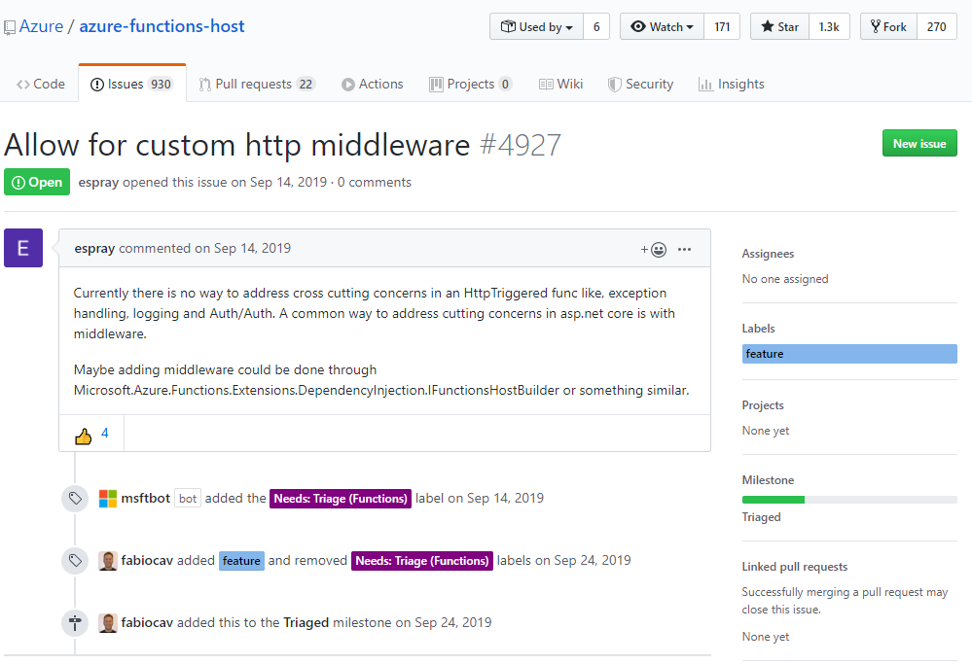
Microsoft should have an equivalent, right?

Slide 22



Slide 23
Attempt #4: “Roll my own”.

Slide 24
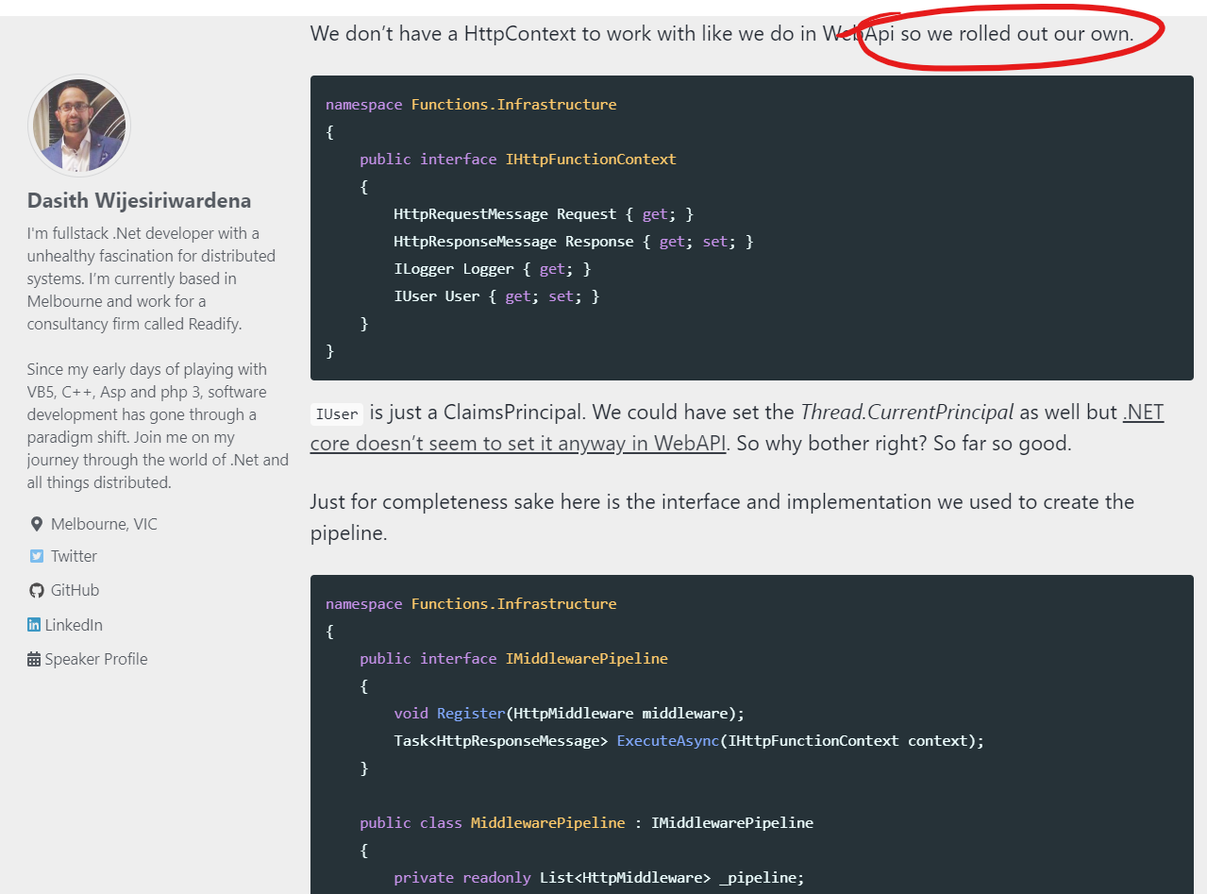

Slide 25

It works, but…

Slide 26


Attempt #5: Ask for help to the Russians.

Slide 27
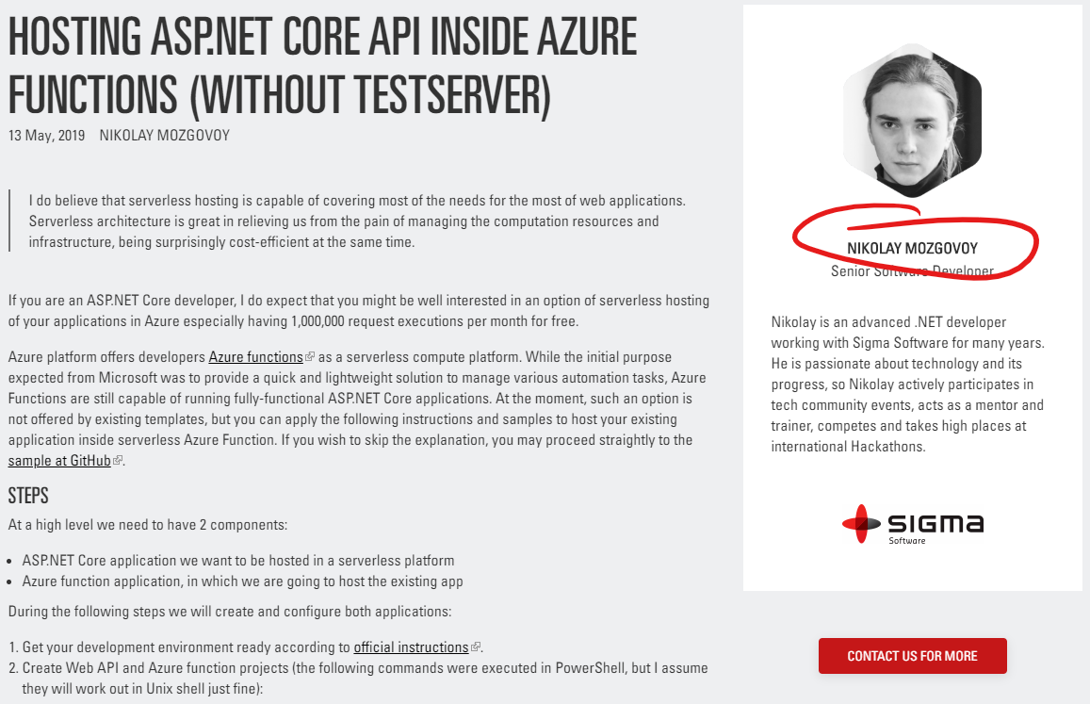


They were listening!

Slide 28
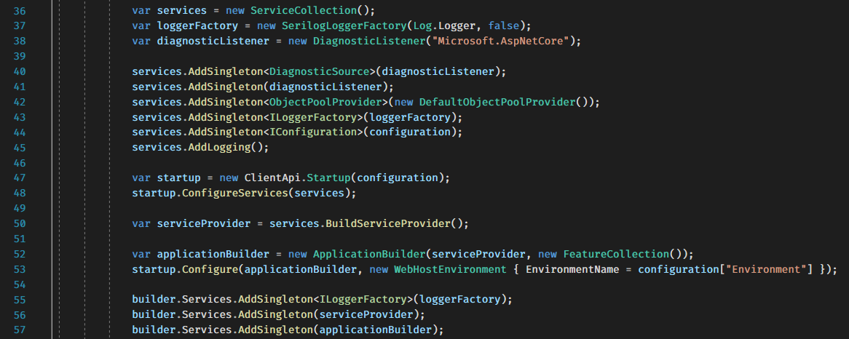
It’s not trivial to configure, but it’s doable.

Slide 29
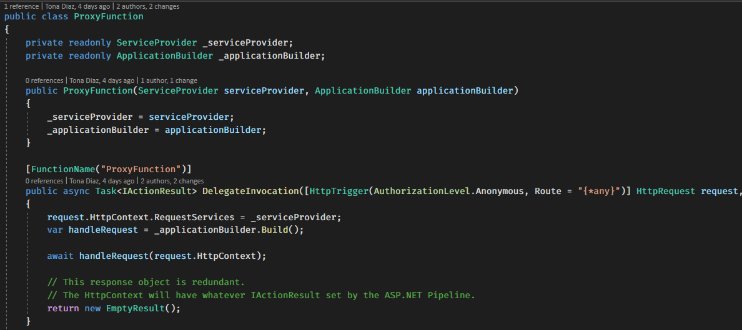
It works*!

Slide 30
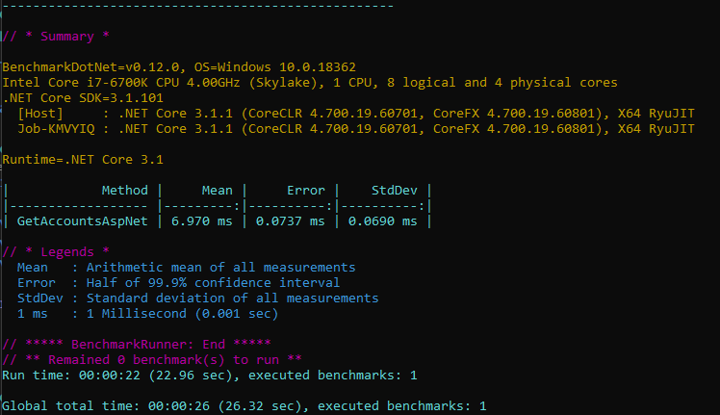
ASP.NET Core on .NET 3.1: 6.9ms.

Slide 31
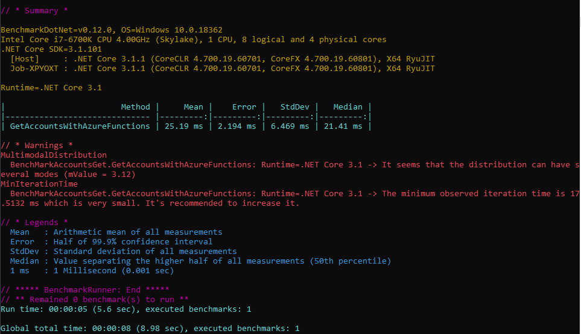
Function Core Tools on .NET 3.1: 25.19 ms.

